Slide 1
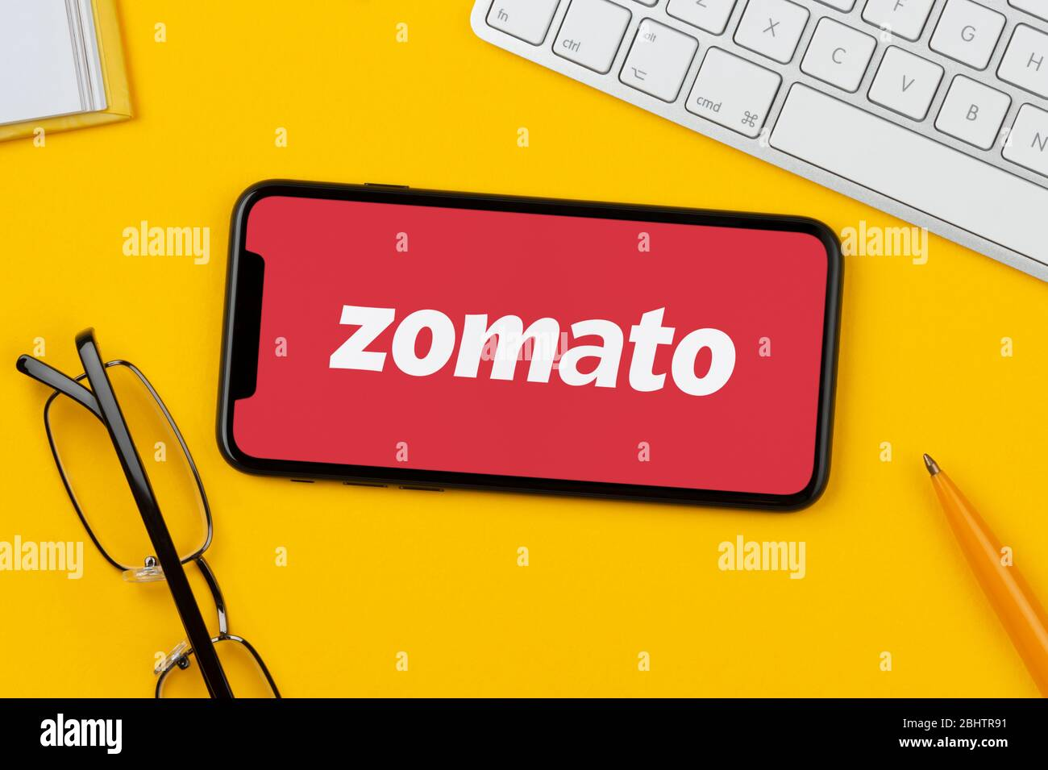
Spreadsheet Project: Zomato Restaurants Analysis
By- Sunil Kumar Samal

Slide 2
Problem Statement
You are hired as a consultant data analyst by Zomato where the team is looking for expansion and opening more restaurants. Your task is to come up with strategies/suggestions about opening newer restaurants.

Slide 3
About Zomato
Zomato is an Indian multinational restaurant aggregator and food delivery startup created in 2008 by Deepinder Goyal and Pankaj Chaddah.
Zomato was founded as Foodiebay in 2008
Renamed as Zomato in 2010
Zomato provides information, menus and user-reviews of restaurants, and also has food delivery options from partner restaurants in select cities.
Operates in 23+ countries including India, Dubai, UK, Brazil, Canada, Australia, Turkey, Poland and New Zealand.
Backed heavily by InfoEdge and other investors, the company has raised about $113 million till date with a valuation of about $660 million.
In 2012, it spread wings globally and started acquiring restaurant listing companies in emerging markets and made five low key acquisitions before gobbling up UrbanSpoon to mark its entry into the biggest of all markets – US.

Slide 4
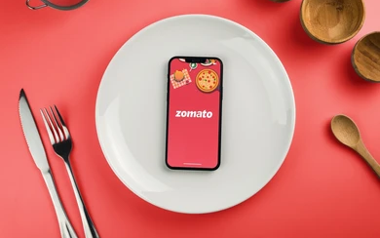
Zomato, data snapshots.
Global presence.
Total 9551 restaurants, across various cuisines & price range
Data cleaning and processing:
Normalised country and currency name for accuracy in location based analysis.
Addressed missing values in cuisines to enhance data integrity.
This data set allows in-depth understanding of Zomato’s market space and operational scopes.
High quality data is crucial for analysing customer behaviour and restaurant performance.

Slide 5




Analytical approach and tools used.
Data Cleaning: Trim, clean and removed duplicated to ensure data accuracy.
Data enrichment: Enhanced the data set by additional variables using VLOOKUP functions to cross reference external data sources.
Descriptive analysis: Employed pivot tables for summarising the key metrics.
Visualisation: created dynamic charts and dashboard for data presentation enabling interactive data exploration.

Slide 6
Analysis and insights.
9551 restaurants across 15 countries.
India is being the least rated country by customers with highest number on restaurants(8652). Rated 2.77 out of 5 with an average of 137 voters.
Philippines is the highest rated country by customers with 4.46 out of 5, average of 407 voters.
Canada has least no of restaurants (4).
Expenditure on food in Australia is the highest.
Highest no of restaurants opened in the year 2018 and lowest in the year 2012.

Slide 7
Count of restaurants in different price ranges.
Price Ranges No of restaurants. 1 4444
2 3113
3 1408
4 586

Slide 8
Analysis for less competition.
Based on the data available, customer ratings were factored against countries to find the market gap where the customers are not getting for what they have paid for or as per the expectation.
Out of 15 countries, here are list of countries where the customers are very least satisfied.
Australia
Canada
Singapore
Brazil
Sri Lanka

Slide 9





Name of the cities, where the competition is less in suggested countries.
After Analysing the price range, no of restaurants and ratings in each city of suggested countries, we have named few cities where we can open restaurants as there are very competition with high market gap based on ratings given by the customers.
For Australia. (Paynesville, Flaxton, Montville)
For Canada. (Yorkton, Consort)
For Sri Lanka. (Colombo)
For Brazil. (Brasí_lia, Rio de Janeiro)
Singapore

Slide 10
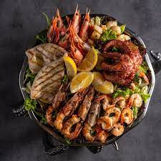
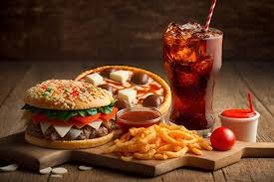
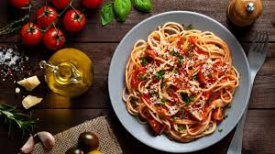


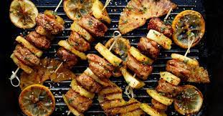
Cuisine Analysis:
Based on the customer ratings available per cuisine, here are the top cuisines people liked in the suggested countries.
Bakery
Seafood
Italian
BBQ
Australian

Slide 11
Analysis of delivery options & name of the competitors in suggested countries.
Every restaurants in the suggested countries offers wide range of delivery options, including table bookings and online deliveries.
Here are the names of few restaurants in the suggested countries which are the biggest competitors with highest customer ratings.
Bridge Road Brewers,
1918 Bistro & Grill
Vivo Bar and Grill
Ministry of Crab
Simply Strawberries By Jagro
Al'frank Cookies
Lake House Restaurant

Slide 12
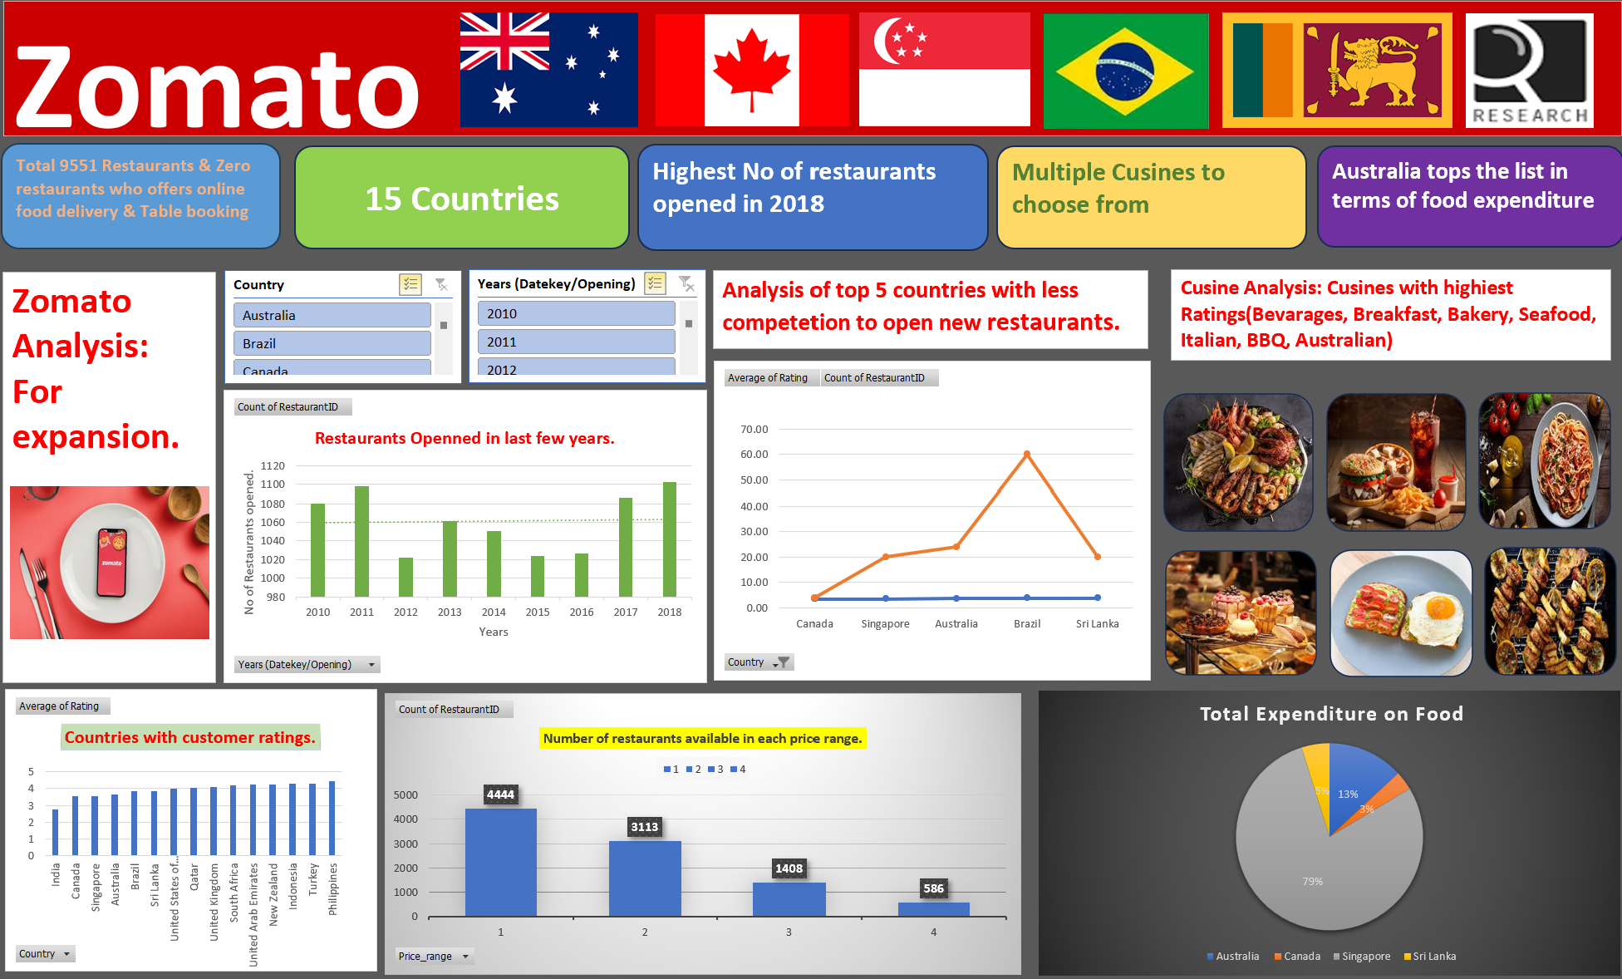
Dashboard

Slide 13

Conclusion
Market penetrations: Identified the regions and cuisine categories, highlighting the expansion opportunities.
Dynamics: Revealed the pattern in restaurants performance, suggested areas to expand.
Comprehensive analysis of Zomato’s restaurants data paves the way for strategic location for expansions and future growths.
Enhance customer satisfaction and these are not numbers- they are signposts to Zomato’s next big leap in the restaurants and food sector.

